Slide 1
Coaching For All: A Supercharging Coaching Event
20th April 2023, Engineer’s House
For any queries please contact Millie.OKeeffe@nhs.net

Slide 2

Creative Coaching Techniques

Slide 3

Welcome & Introductions
What creative coaching techniques do you use?

Slide 4




Why Creative Coaching?
Providing a different perspective
Unblocking Ideas
Unlocking potential
Enabling free flow of ideas

Slide 5
Techniques for us to explore
Using pictures
Using space in a room
Chair work (perceptual positioning)
Using diagrams
Notes:
Designed by Pip Wilson & Ian long

Slide 6
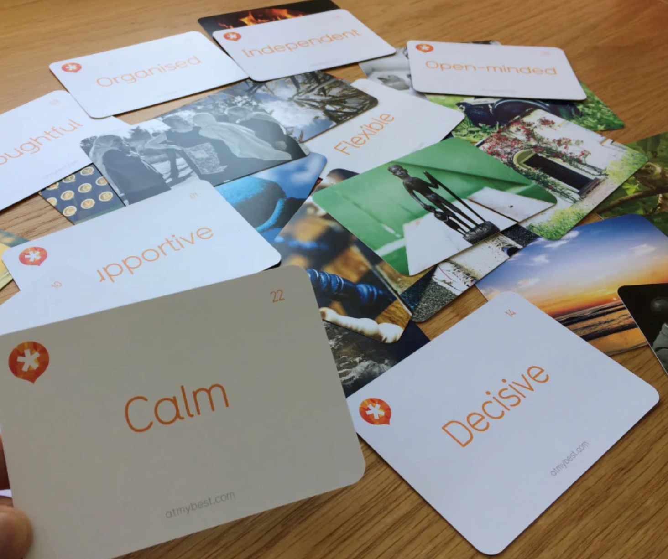
Using Pictures
Notes:
Designed by Pip Wilson & Ian long

Slide 7
Using space in a room
Use space for visualization
Choose a space that represents ‘now’
- How does it feel? What is going on in the present?
- What do you want to achieve? What is ahead of you?
2. Choose another space in the room that represents a time in the future when you have achieved your goal.
- How are you in this moment? What do you notice about your body language, your posture, your breathing? What is going on for you?
- What has helped you to get here?
- As you look back to the other place in the room, what resources have enabled you on your journey?
Notes:
Designed by Pip Wilson & Ian long

Slide 8
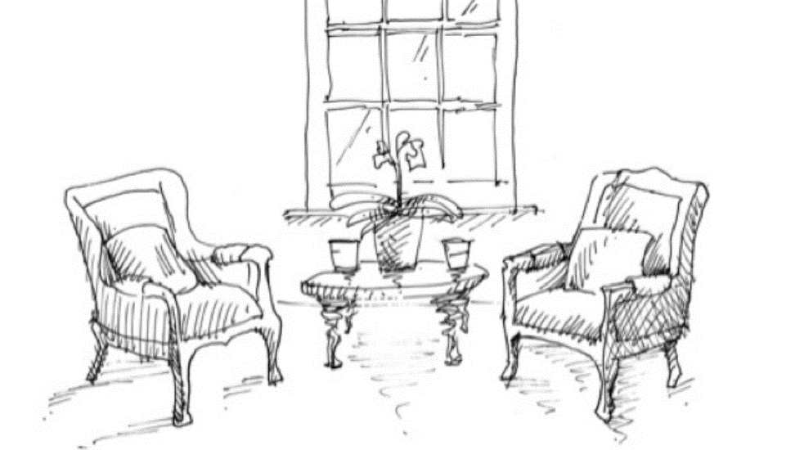
Chair Work
Often used to work through conflict
Ask the coachee to sit opposite the empty chair
What do they want to say? No holding back. What do they want the other person to know, do and feel?
What are they holding back?
2. Ask the coachee to now sit in the opposite chair
What might the other person have experienced as you said what you wanted?
What key words?
What was your body language saying?
What was important about your tone?
What do you imagine they felt as you spoke?
Notes:
Designed by Pip Wilson & Ian long

Slide 9

Blob Trees
Created by Pip Wilson & Ian Long
Notes:
Designed by Pip Wilson & Ian long

Slide 10
Blob Trees – Group Activity
Task 1 – Take on the role of the coachee and place your person on the tree.
Explain why you have put your person where you have on the tree
Tasks 2 – Now take on the role of a coach and think about the questions you would now ask your coachee, once they have placed their person on the tree
Created by Pip Wilson & Ian Long
Notes:
Designed by Pip Wilson & Ian long

Slide 11


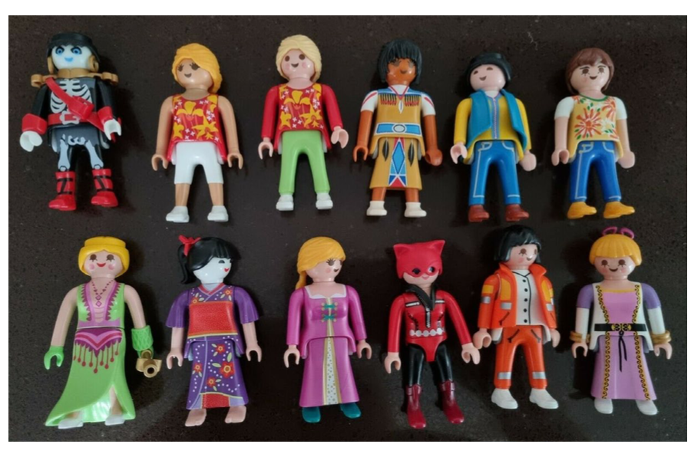


Additional Resources
Notes:
Designed by Pip Wilson & Ian long

