Slide 1
Coaching For All: A Supercharging Coaching Event
20th April 2023, Engineer’s House
For any queries please contact Millie.OKeeffe@nhs.net

Slide 2
Connecting Through Coaching
Steph Snade

Slide 3
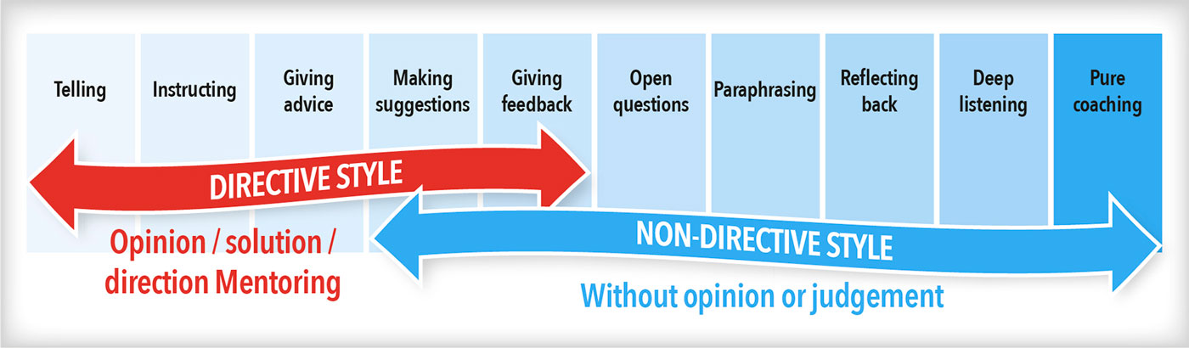
Coaching Continuum

Slide 4
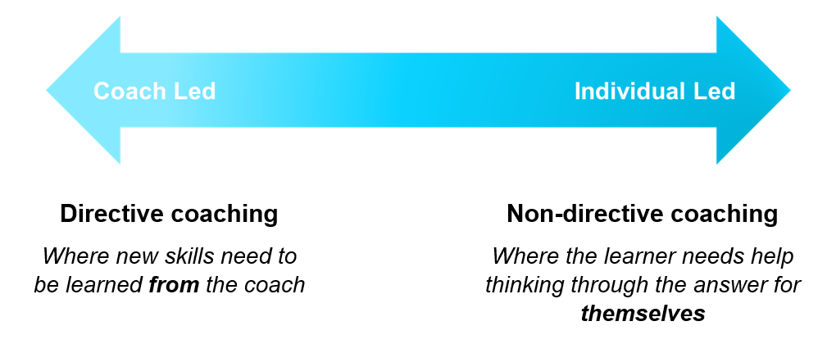
Coaching Continuum

Slide 5
Good Old GROW
Goal
What do you want to achieve?
Reality
Where are you now?
Options
What could you do?
Will
What will you do next?

Slide 6
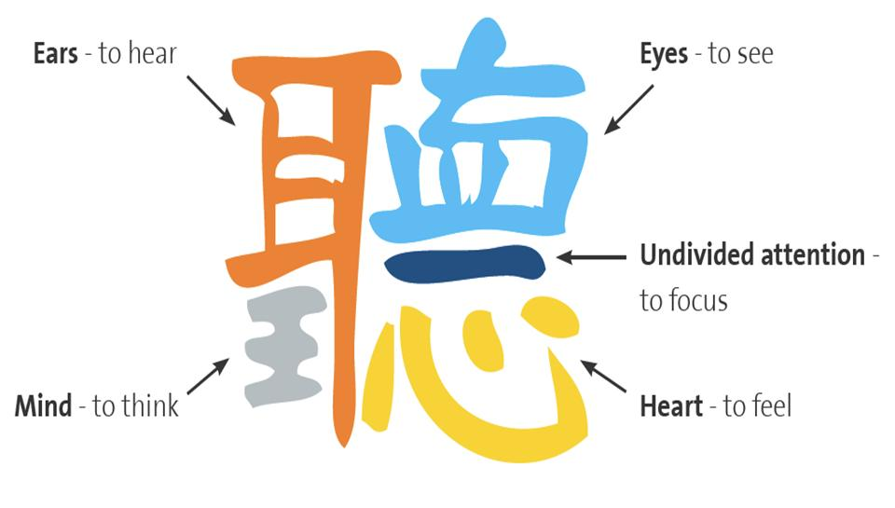
Listen Character
Notes:
“聽,” the Chinese character for “listen,” consists of six components. The six components in “聽” are: “耳” (ear), “王” (king), “十” (ten), “目” (eye), “一” (one), and “心” (heart).
You can interpret these six components as follows:
When you listen,
you use an ear to hear
while treating the other like a king (or while using a kingly mind to listen)
with the focus of ten
eyes
and the feeling of one united
heart.

Slide 7
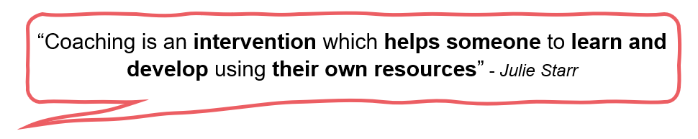

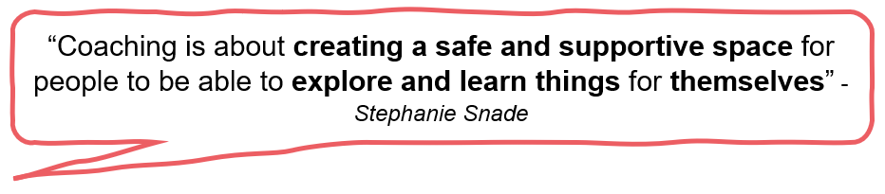
What is coaching?

Slide 8
“Coaching is profoundly beneficial in the eyes of companies and individuals who hire a coach, with 99% viewing it as “satisfied or very satisfied” and 96% stating, “they’d repeat the process.” (ICF Global Coaching Client Study)
Notes:
https://www.ipeccoaching.com/hubfs/What%20is%20Coaching%20-%20iPEC%20Coach%20Training.pdf pg.10

Slide 9
Benefits of Coaching - Practical

Slide 10

Relationships 73%

Slide 11

Communication Skills 72%

Slide 12

Work Performance 70%

Slide 13




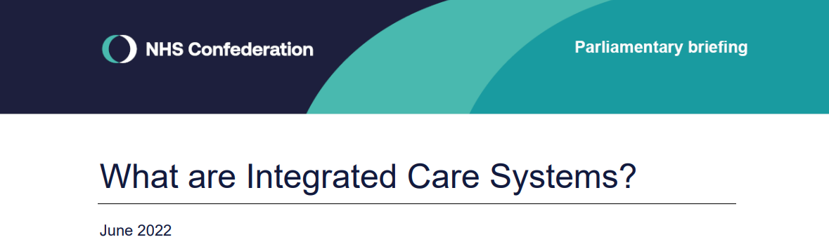

Slide 14
Benefits of Coaching - Wellbeing

Slide 15

Self Esteem / Confidence 80%

Slide 16

Work/Life Balance 67%

Slide 17

Wellness 63%

Slide 18
Importance of Coach Attributes
Coach’s Confidence 74%
Personal Compatibility 80%
Personal Rapport 83%
Notes:
When selecting a coach

Slide 19

What do you want to get out of today?

