Slide 1
Coaching For All: A Supercharging Coaching Event
20th April 2023, Engineer’s House
For any queries please contact Millie.OKeeffe@nhs.net

Slide 2
Health Coaching – What matters when it comes to health and wellbeing
Making Every Conversation Count

Slide 3
My name is Steve

Slide 4
Activity
What was the nature of your earliest health-related thoughts?
Thinking about the circumstances and your motivation at the time.
In pairs – Ask each other one question about your colleagues story

Slide 5
Objectives
Consider what Health Coaching means to us
The diversity of factors that influence a healthier life
Having motivation to sustain behavioural change
for improved health
The future of the NHS with health coaching

Slide 6

Coaching
From early forms of transportation, i.e. stage coach, the word “coaching” literally means to transport someone from one place to another. One thing that all forms of coaching have in common is that people are using it to help them move forward in a certain direction.

Slide 7
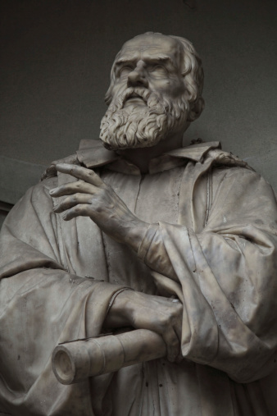
Galileo
‘You cannot teach someone anything. You can only help them discover it within themselves’.

Slide 8
What could Health Coaching be?
Enabling people to become more active in their care to optimise well-being and health

Slide 9
What could Health Coaching be?
Raise awareness and increase one’s responsibility for self-management

Slide 10
What could Health Coaching be?
A behavioural intervention that facilitates attainment of health-promoting goals in order to a achieve lifestyle-related behavioural change

Slide 11
What does health coaching mean…
… to me?
… my family and friends?
… to my community?

Slide 12
Spirit of Health Coaching
Person-centred
Highly contextual
Deeply sensitive
ABIDING GRACE
Affirmation
Unconditional Positive Regard

Slide 13
What matters for health change?
There can be many factors that affect one’s health and well-being.

Slide 14
Thinking about the way I…
move
sleep
eat
WHAT MATTERS TO YOU?
socialise
rest
feel

Slide 15
Activity
Think and discuss what matters from your perspectives
We will bring all the responses together to portray the ‘what matters to our Supercharged Coaches’ summary

Slide 16
Motivation to change health

Slide 17
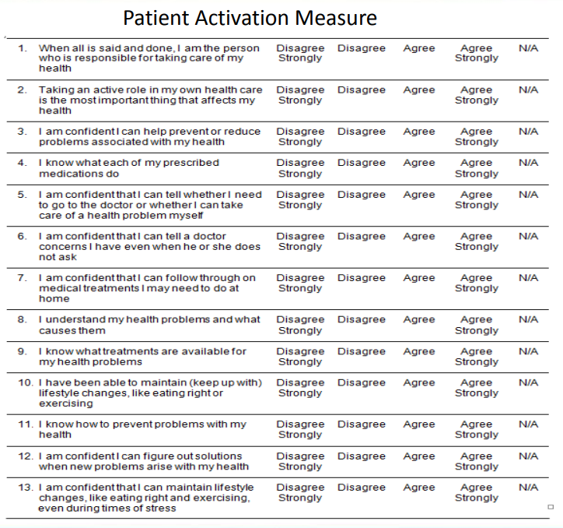
Patient Activation Measure

Slide 18
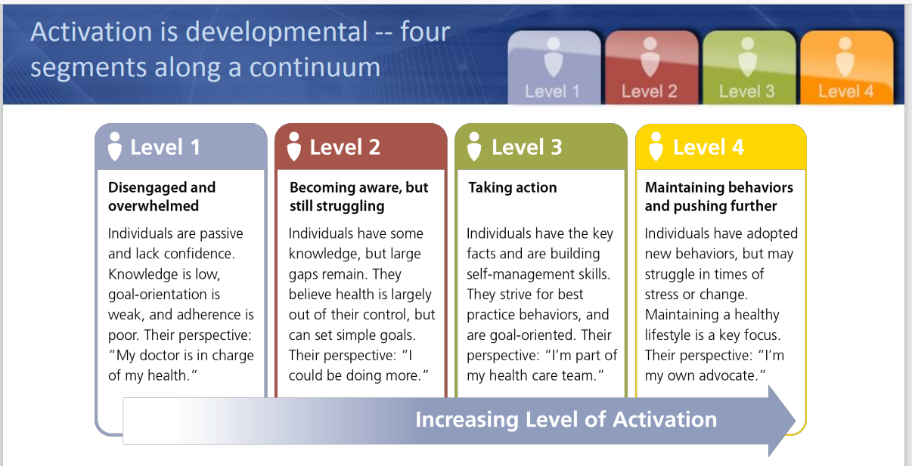
Ready to change?

Slide 19





Future Health Coaching in the NHS

Slide 20
How we could use Health Coaching
Integrating into exist working practice
Clinicians, supervision, leadership, peer support

Slide 21
How we could use Health Coaching
Integrating into exist working practice
Integrated into other coaching areas
Leadership, Organisational Change

Slide 22
How we could use Health Coaching
Integrating into exist working practice
Integrated into other coaching areas
As a specific Health and Wellbeing role
NHS Health and Wellbeing Coach, support Organisation Staff Wellbeing programmes

Slide 23
How we could use Health Coaching
Integrating into exist working practice
Integrated into other coaching areas
As a specific Health and Wellbeing role
In strategic planning
Proactive at all levels in advocating and promoting health coaching

Slide 24
What is the next small change
From our conversations today, what will you think about changing
for yourselves,
in your role
and with those around you.

Slide 25
Health Coaching Pledge
Consider sharing one thing you will do now to enhance the benefits of health coaching for you and those around you

