Slide 1
Coaching For All: A Supercharging Coaching Event
20th April 2023, Engineer’s House
For any queries please contact Millie.OKeeffe@nhs.net

Slide 2
Solutions Focus in Coaching
Steve Thom: Organisation Development Lead, Sirona care and health

Slide 3
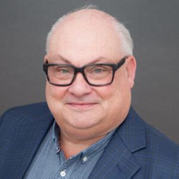
Why Solutions Focus?
12,00 to 50,000 thoughts per day. What percentage are negative?
80% National Science Foundation: 2005
"Change is happening all the time: therefore the simple way is to find USEFUL change and amplify it".
Dr Mark McKergow, Co-director, sfwork - The Centre for Solutions Focus at Work

Slide 4
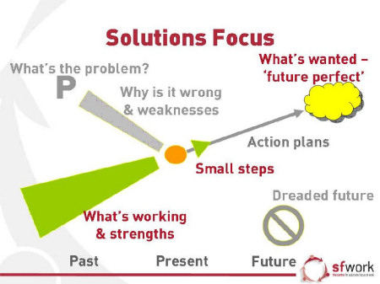

Slide 5
Outcome - The Miracle Question
“Suppose tonight you go to bed and go to sleep as usual. And during the night, a miracle happens. And the problem vanishes. And the issues that concern you are resolved, but you’re still asleep. Therefore, you don’t know that the miracle has happened. When you wake up tomorrow, what will be the first things that will tell you that the miracle has happened? How will you know that the transformation has occurred?”

Slide 6
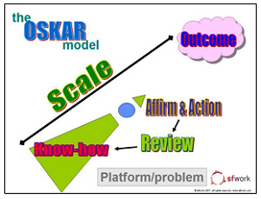
Meet OSKAR:
Outcome: Future perfect – the miracle question
Scaling: On a scale of 1 – 10, where are you know?
Know How: What’s makes it n and not less? What helps you to perform at n? When have you done something similar before? How have other people achieved this?
Action: What’s already going well? What is the next small step? What could you do to get there? Having heard all of those possibilities, what will you do?
Review: What’s better since our last session? What might be next?

Slide 7

Don’t take the monkey…
Leave the responsibility where it belongs.
So instead of giving advice, you could…
Offer Possibilities:
“I don’t know if this could work for you, but…”
“I used to work with someone called Millie, who was a real expert in this area…”
“I was once in a similar situation… what worked for me was...”

Slide 8
Feedback
Solutions Focus mindset – notice what worked and strengths
After the coaching:
  Coachee: What was it like to be coached? What could the coach do more of?
  Observer: What did you notice the coach doing well?
  Coach: What was it like to use Solutions Focus? What could you build on for next time?

Slide 9
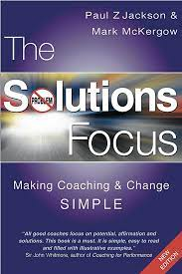

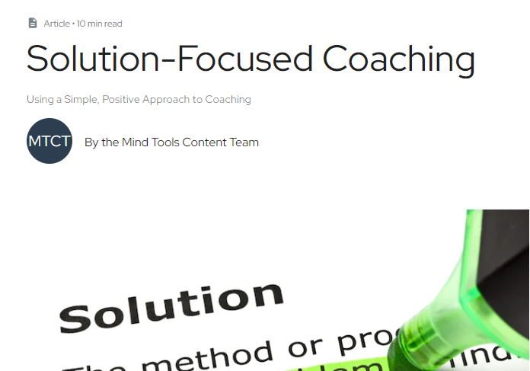
Resources
https://sfwork.com/solutions-focus
https://www.mindtools.com/axbkkls/solution-focused-coaching

