Slide 1
The Bristol, North Somerset and South Gloucestershire Integrated Care System (ICS) Latest update: June 2023

Slide 2
Introduction to our Integrated Care System (ICS) in BNSSG
Integrated Care Systems bring together a range of partner organisations to help people to stay happy, healthy and well. They are also designed to ensure that health and care services join up around individual needs – breaking down the boundaries between physical health, mental health and social care services.
In Bristol, North Somerset and South Gloucestershire we have been working in this way for some time. Our system partnership is known as ‘Healthier Together’.
The Health and Care Act formalised new arrangements to ensure ICSs became statutory entities from 1 July 2022.
This move gives us the opportunity to build on the successes of our Partnership to date, and accelerate progress on behalf of the people and communities we serve.

Slide 3
Our ‘ICS system’ is made up of…
Voluntary,
Community & Social Enterprise Partners
Our
Integrated Care System
Integrated Care System: The collective name for all the health and care services working together in BNSSG. Known locally as ‘Healthier Together’

Slide 4
Our 1 million population is served by…
BNSSG health and care system by numbers
 | Around 50,000 health and care staff |  | 3 local authorities
 | 76 GP surgeries, 1 GP Federation and 1 GP Collaborative |  | 64 dental practices and 1 dental committee
 | 1 community provider |  | 171 pharmacies and 1 pharmacy committee
 | 101 opticians and 1 optometry committee |  | 1000s of voluntary, community and social enterprise organisations
 | 278 care homes |  | 1 mental health trust
 | 2 acute hospitals (across 14 sites) |  | 20 primary care networks
 | 1 integrated care board |  | 1 ambulance trust
 | 1 academic health science centre |  | 1 Healthwatch
 | 6 locality partnerships |  | 56 children’s centres

Slide 5
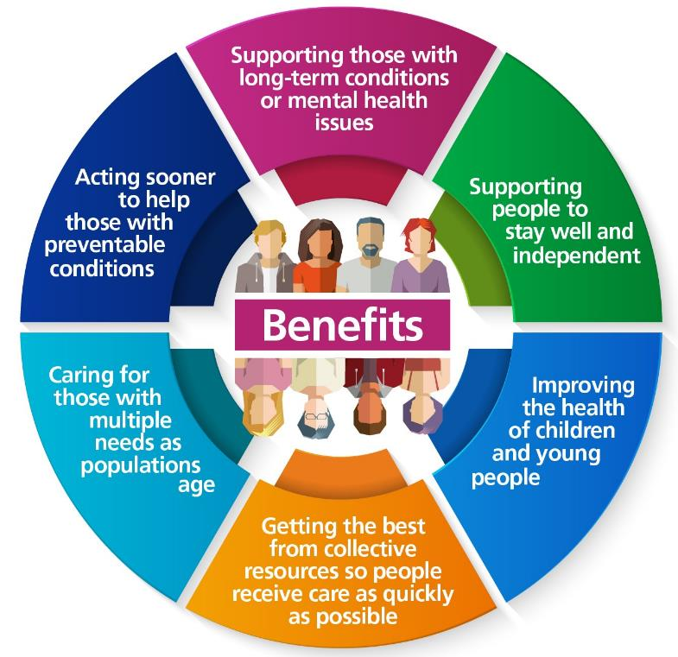
The purpose of ICSs
Integrated Care Systems are designed to:
Improve the health of the population and health and care services
Remove inequalities in people’s experience, access to care and results
Make best use of resources, working efficiently and effectively
Support wider social and economic development in our communities
Our ICS is comprised of an Integrated Care Partnership, an Integrated Care Board and six Locality Partnerships.

Slide 6
The ICS in BNSSG is organised into…
Integrated Care Partnership: Meeting of senior civic, community and health leaders in BNSSG. Sets overall strategic direction for the system
ICB Board: Decision making body including partnership representatives and non-executive members. Responsible for delivering the strategy and jointly deciding how to spend NHS money
ICB Board Committees: Chaired by non-executive members of the ICB Board, but also attended by non-executive directors of member organisations
Integrated Care Board: Staffed by people previously working in the CCG, but are now working to the instructions of the ICB Board, on behalf of the whole system (no purchaser/provider split)
Locality partnerships: Working at a local level within the ICS responding to the unique needs of local populations

Slide 7
The BNSSG ICS in more detail
What is the Integrated Care Partnership (ICP)?
The Integrated Care Partnership is a statutory committee. It brings together a range of partners including NHS organisations, local authorities and representatives from voluntary sector and community groups. It is responsible for setting the overall strategic direction for the system.
The Integrated Care Board is the new organisation responsible for the planning and allocation of NHS resources. Now that ICBs are legally established, Clinical Commissioning Groups across the country have been abolished. The organisation is governed by an ICB Board which is made up of NHS and local authority chief executives.
Locality Partnerships operate on a smaller scale within the ICS, responding to the unique needs of local populations. The six in our area are South Gloucestershire, North and West Bristol, Inner City and East Bristol, South Bristol, Woodspring, and Weston, Worle and Villages. Locality Partnerships may include general practice, social care, community services, hospitals, voluntary sector, and mental health services – working alongside local people and communities to improve health and wellbeing.
What is the Integrated Care Board (ICB)?
What are Locality Partnerships?

Slide 8
What is an integrated care system? NHS England video
Notes:
(1) Strong Integrated Care Systems Everywhere - YouTube

Slide 9
Integrated care in every community. NHS England video
Notes:
(1) Integrated care in every community - YouTube

